Slide 1
Cloud Monitoring Dashboard Study Using Azure Monitor for Virtual Machine Performance Monitoring
Course Code: 6IT1284
Course Name : Hybrid Cloud Architecture and Management
Faculty Name : Dr Durgadevi P
Team Number:
Student Name - Register Number
Peddakotla Vennala-2023BIFT07AED064,
Thejashri S - 2023BIFT07AED005,
Reethika M - 2023BIFT07AED063

Slide 2
Introduction
Overview of the Project
This project focuses on monitoring the performance of a Virtual Machine using Azure Monitor. It collects and visualizes real-time metrics such as CPU and memory usage through graphs and dashboard.
Problem Statement
In traditional systems, it is difficult to track resource performance in real time, which may lead to inefficiency and delayed issue detection.
Why this Micro Project is Important
Helps in real-time monitoring of cloud resources
Improves system performance analysis
Reduces manual effort in tracking data
Essential for modern cloud-based applications

Slide 3
Objectives
Main Goals of the Project
To monitor the performance of a Virtual Machine in Azure
To collect real-time data using Azure Monitor
To visualize system metrics through graphs and dashboard
Aim to Achieve
Analyze CPU and memory usage of the VM
Understand cloud monitoring concepts
Improve system performance tracking
Gain hands-on experience with Azure tools

Slide 4
Problem Statement
Clearly Define the Issue
Monitoring the performance of cloud resources like Virtual Machines is challenging without proper tools, as it is difficult to track CPU and memory usage in real time.
Existing Challenges
Lack of real-time performance visibility
Difficulty in identifying system issues quickly
Manual monitoring is time-consuming
Inefficient resource utilization

Slide 5
Proposed Solution
Idea / Approach
Use Azure Monitor to monitor VM performance
Collect real-time metrics like CPU and memory usage
Visualize data using graphs and dashboard
How it Solves the Problem
Provides real-time performance tracking
Helps detect issues quickly
Reduces manual monitoring effort
Improves efficient resource usage

Slide 6
Technologies Used
Platform - Microsoft Azure
Tools - Azure Portal
Azure Monitor
Resources Used - Virtual Machine (VM)
Programming Languages - Not required (No coding involved in this project)
Frameworks - Not applicable

Slide 7
System Architecture
Workflow
[ Virtual Machine (VM) ]
↓
[ Azure Monitor Metrics ]
↓
[ Data Processing & Analysis ]
↓
[ Dashboard / Graph Visualization ]
Explanation:
📥 Input
Virtual Machine performance data
CPU usage
Memory usage
⚙️ Process
Azure Monitor collects metrics
Data is analyzed and processed
Metrics are converted into visual graphs
📤 Output
Performance graphs (CPU & Memory)
Dashboard visualization
Real-time monitoring results

Slide 8
Methodology / Working
Flowchart
Start
↓
Create VM
↓
Open Azure Monitor
↓
Select Metrics
↓
Choose VM
↓
Select CPU & Memory
↓
Generate Graph
↓
Display Dashboard
↓
End
Step-by-Step Working
Create a Virtual Machine in Azure
Open Azure Monitor
Select Metrics option
Choose the Virtual Machine (monitor-vm)
Select metrics (CPU, Memory)
Generate graphs
Add metrics to dashboard

Slide 9
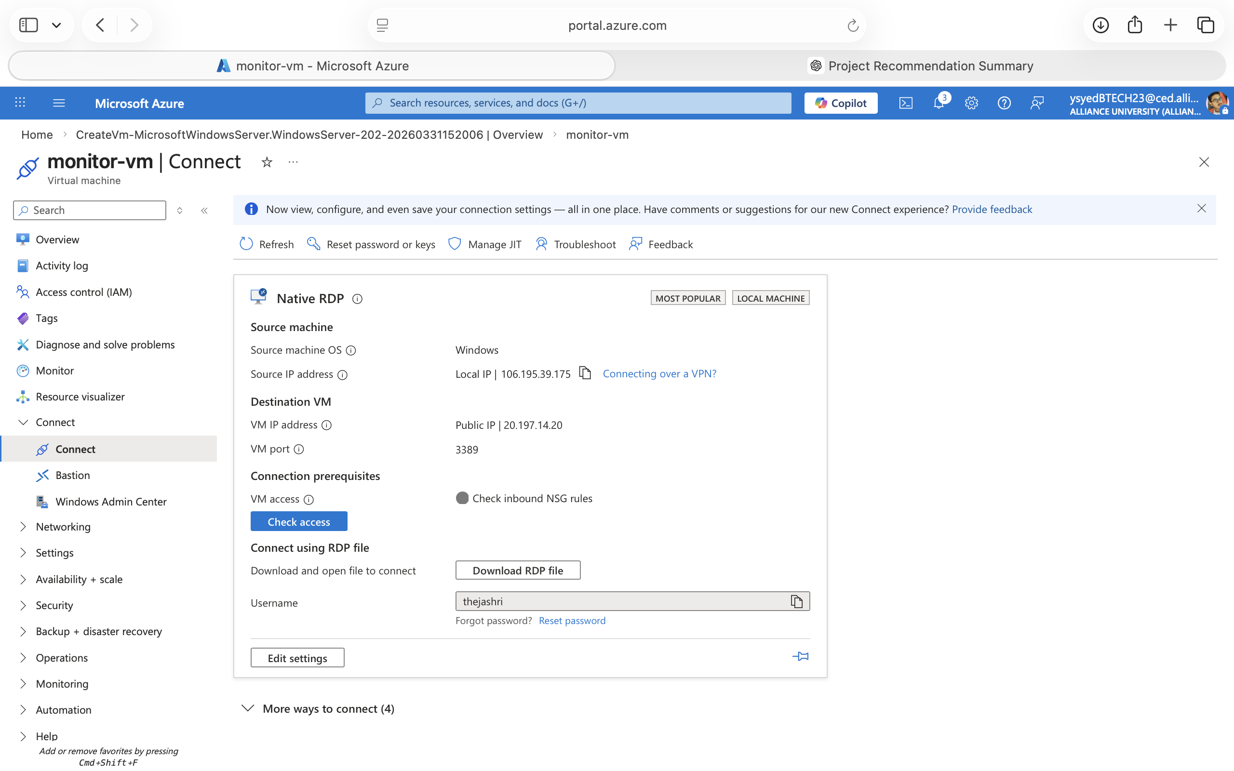
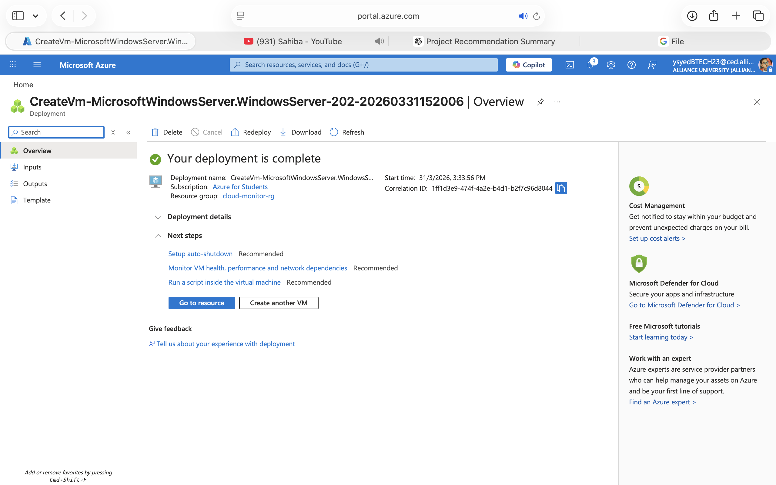
Implementation
Screenshots of the Project

Slide 10
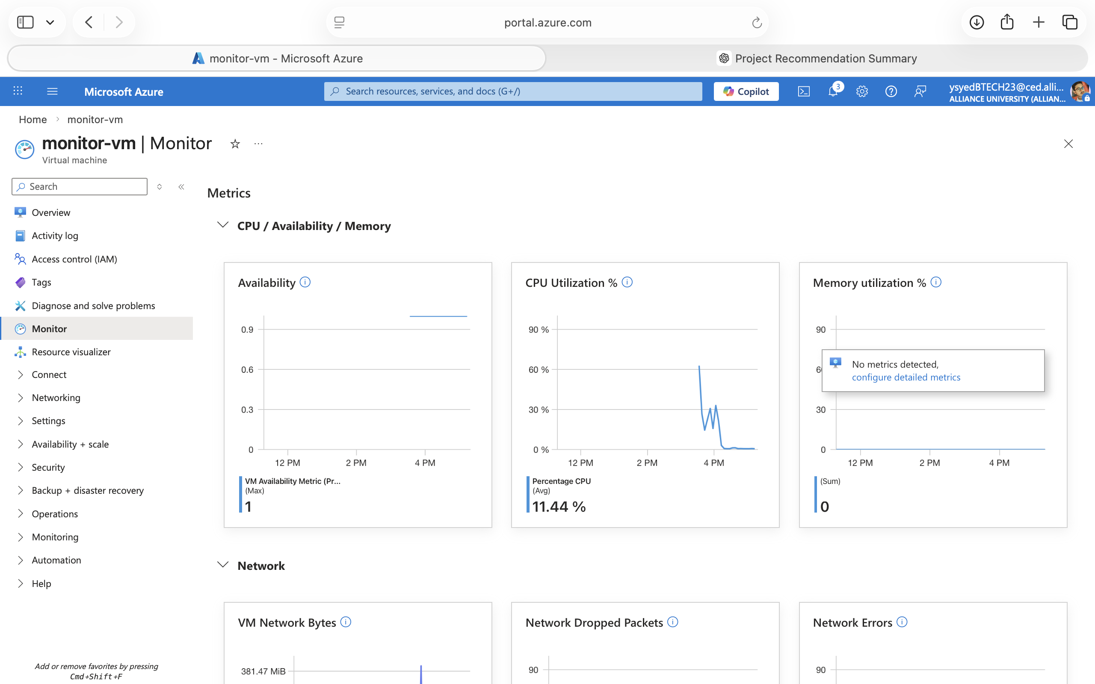
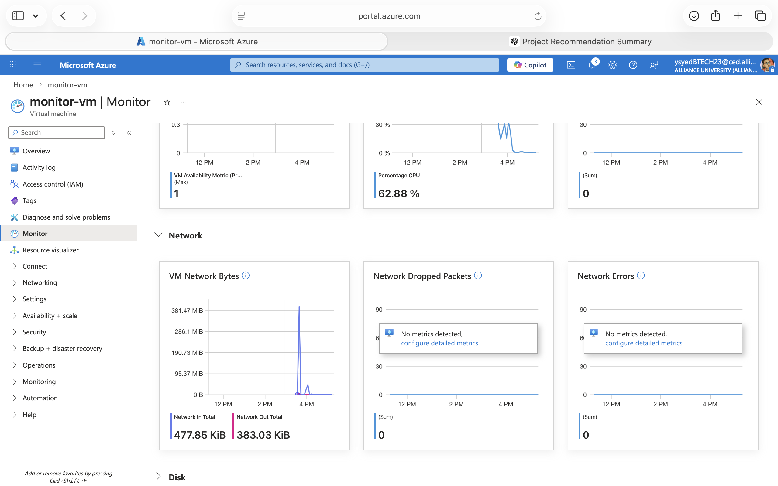
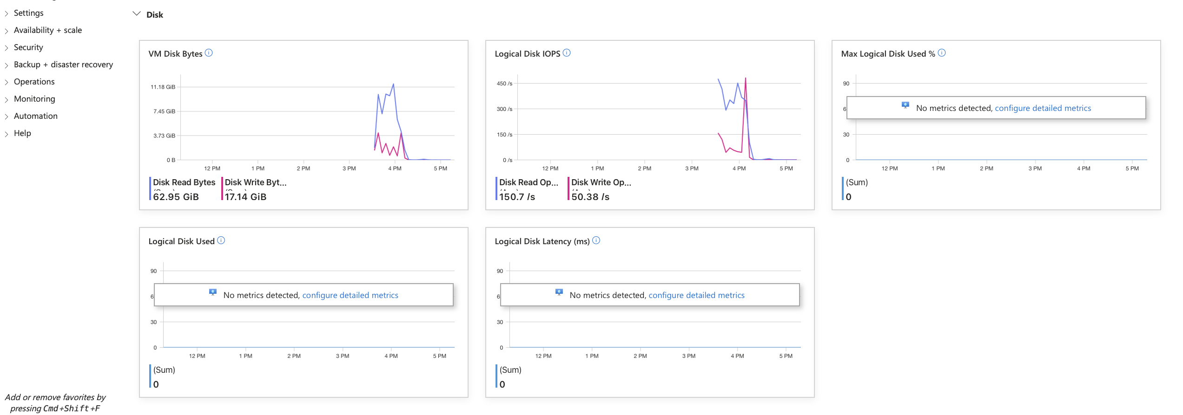

Slide 11
Key Features
Real-time monitoring of Virtual Machine
Visualization of CPU and memory usage
Easy-to-use Azure Monitor interface
Dashboard with multiple metric tiles

Slide 12
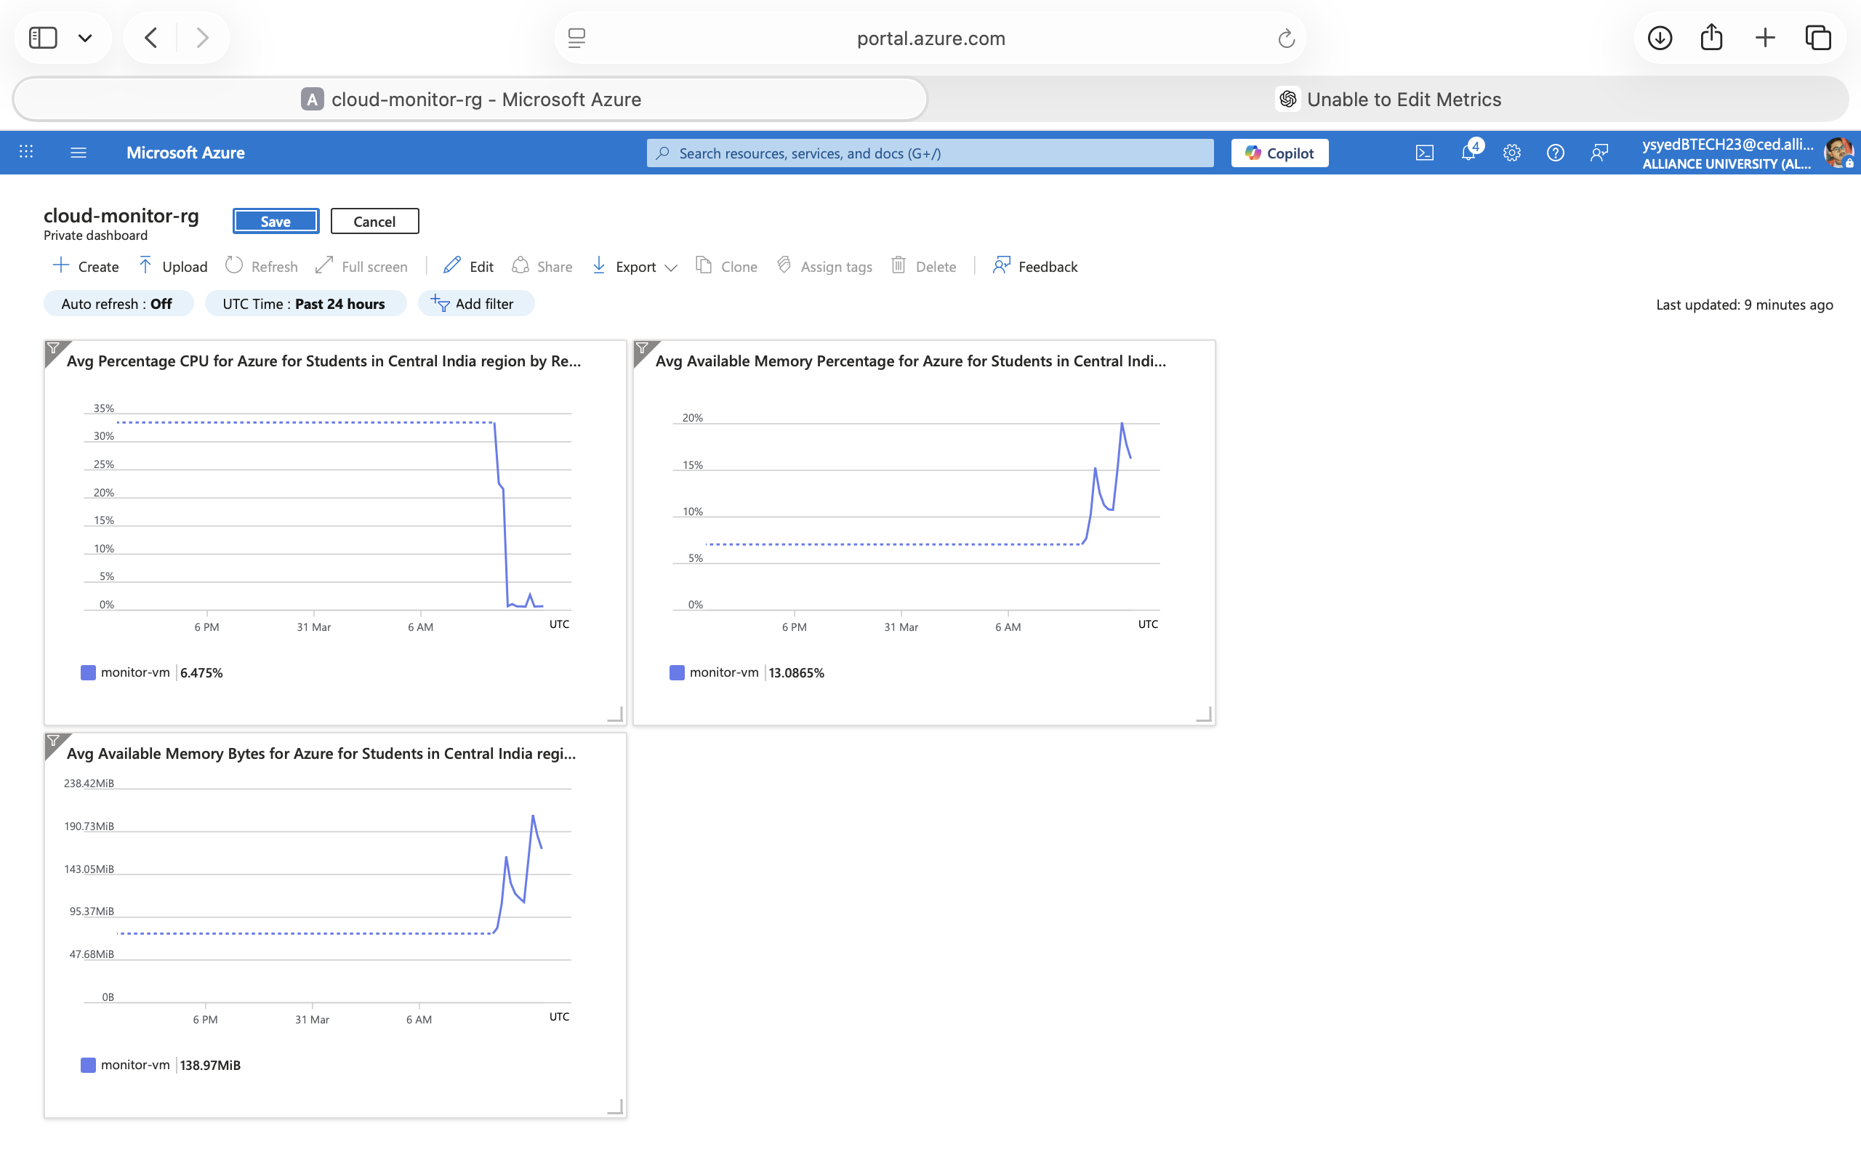
Results
Output Screenshots
Performance / Observations
CPU usage varies based on system activity
Memory usage remains stable during operation
Real-time graphs help in performance analysis
System monitoring is accurate and efficient

Slide 13
Advantages & Limitations
Advantages
Easy to use
Cost-effective
High availability
Efficient performance
Automatic failover
Limitations
Depends on internet
Configuration complexity
Possible setup errors
Slight delay in data sync

Slide 14
Future Scope / Improvements
Implement Auto Scaling to handle high traffic
Add advanced security mechanisms (firewall, encryption)
Use AI-based monitoring and alert system
Expand to more geographic regions
Improve database replication and synchronization
Integrate load balancing within each region

Slide 15
Conclusion
Summary of the Project
Designed a multi-region cloud infrastructure using Microsoft Azure
Deployed virtual machines in Central India and East US
Configured Traffic Manager for routing and failover
Implemented disaster recovery mechanism
Final Outcome
Achieved high availability and fault tolerance
Ensured continuous service during failures
Successfully demonstrated automatic failover between regions
Reduced downtime and improved system reliability

Slide 16
References
Books
Cloud Computing: Concepts, Technology & Architecture – Thomas Erl
Distributed Systems Principles – Andrew S. Tanenbaum
Websites
https://learn.microsoft.com/azure
https://azure.microsoft.com
https://www.geeksforgeeks.org
https://www.tutorialspoint.com
Research Papers
“Cloud Computing and Disaster Recovery” – IEEE
“Multi-Region Cloud Architecture for High Availability”
Tools Used
Microsoft Azure
Azure Portal
Virtual Machines
Traffic Manager
Apache Web Server

Slide 17
Thank You

